Slide 1
TOPIC 5:​ ​ TRAINING AND DEVELOPMENT​

Slide 2

1.Types of training programs

Slide 3

TRAINING is the act of increasing the knowledge and skills of an employee for doing a particular job. It imparts specific skills for specific purposes.

Slide 4

DEVELOPMENT includes the process by which managers and executives acquire not only skills and competency in their present jobs but also capacities for future managerial positions.

Slide 5

TYPES OF TRAINING PROGRAMS

Slide 6

JOB TRAINING - the purpose is to increase the knowledge of workers about the jobs with which they are concerned so that their efficiency and skill of performance are improved.

Slide 7

REFRESHER TRAINING - employees are formally trained for their jobs, but with the passage of time, they may forget some of the methods which were taught to them or some of the methods or all of them may have become outdated because of technological development.

Slide 8
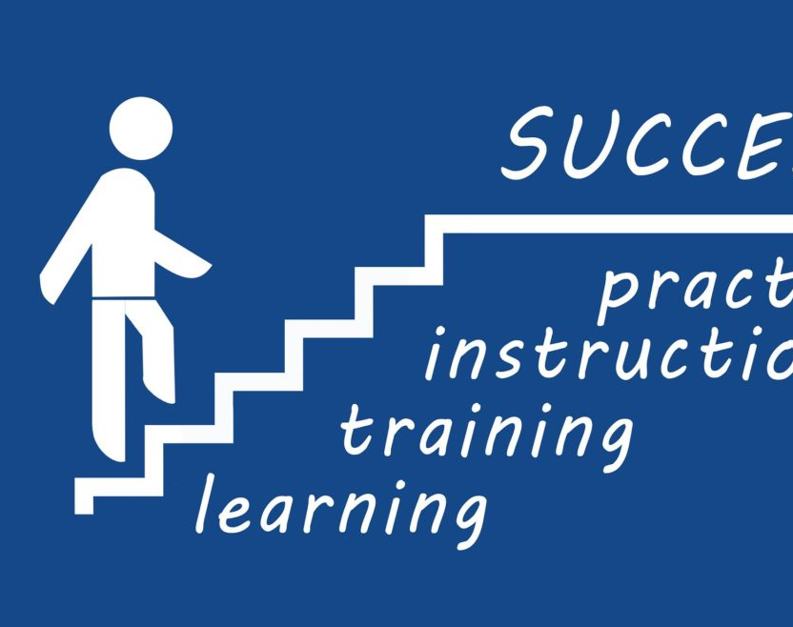
PROMOTIONAL TRAINING- preparing the potential candidate to handle more duties and responsibilities, thereby making him/her eligible for promotion to higher jobs in the organization.

Slide 9

BASIC LITERACY TRAINING - training for things like reading, writing and problem-solving skills.

Slide 10

INTERPERSONAL SKILLS TRAINING - training on how to maintain positive relationships, communicate better, resolve conflicts and build trust.

Slide 11
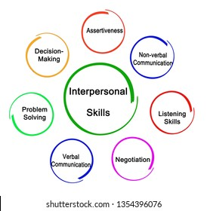


Slide 12

TECHNOLOGY TRAINING - training on computer software and hardware offered to specific crew members depending on their position.

Slide 13
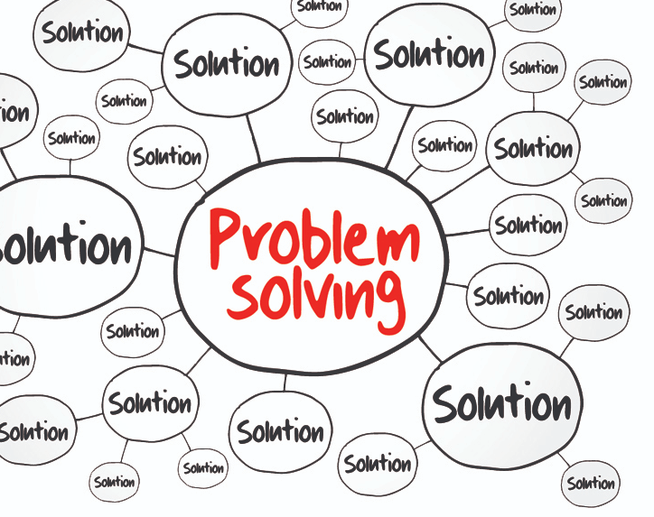
PROBLEM-SOLVING TRAINING - training on how to analyze problems and make decisions and is mandatory for all crew members.

Slide 14
The following points are to be ensured for the success of a training program:

Slide 15

The trainer
The choice of faculty is critical to the success of any training program. The HR coordinator must ensure that the selected trainer has the necessary general, technical and specialized knowledge of the subject, that his experience and skills are reflected in handling the training sessions, adapting his training style, generating interest in the subject being dealt with and that he/she possesses the personality characteristics and attitudes such as openness to new ideas, observation power, a questioning mind and willingness to experiment.

Slide 16

The trainees
It should be ensured that the trainees have the necessary background, experience, intellectual and physical capabilities, diagnostic and application skills and personality characteristics required.

Slide 17

The curriculum
The curriculum should be designed for the optimal utilization of resources available towards the achievement of the program objective.

Slide 18

The training material
Care should be taken to ensure that the relevance and suitability of training material and the media of presentation to the subject under consideration.

Slide 19

The methods and techniques
The training methods and techniques should contribute to maintaining interest and high degree of participation, and are capable of including a transfer of knowledge and skills.

Slide 20

The timing and sequencing
It should be ensured that the timing and sequencing of session are suitable with regard to the training objectives.

Slide 21

Location
In selecting a venue for the training, the adequacy of the room ventilation, relative freedom form noise and disturbances and overall comfort should be sought. It should be ensured that the location is worth the cost and that the surrounding is suitable to create a good training environment.

Slide 22

The physical facilities and training equipment
The availability of certain basic facilities e.g. overhead / LCD projector, smart board should be ensured.

Slide 23
Many organizations, even though they have a large training staff and spend a large amount on training programs, don’t get good results. In order to ensure that the training programs are effective and the organizations get good results from them, the following may be observed:

Slide 24

Determination of training needs. The management should first decide the training needs of employees and then select a method of training that is most effective.
Relevance to job requirements. Training programs must be related to the requirements of the job for which they are invited.
Allowance for individual differences. There are differences in ability, learning capacity and interest of trainees so the management should consider these factors while designing the training programs.
Training program should be result oriented. Management should avoid “training for the sake of training” and show greater interest in the benefits of training programs.
Suitable incentives. There should be incentives to the trainees to make them take training programs seriously.
Management support. Top management should take interest in and support the training programs. Subordinates cannot be expected to take the training programs seriously if their superiors themselves are not serious about them.

Slide 25
2.Training and development methods

Slide 26
There are numerous methods and materials available to help you prepare and equip employees to better do their jobs. Indeed, with so many choices out there, it can be daunting to determine which methods to use and when to use them. And using several methods for each training session may actually be the most effective way to help employees learn and retain information.

Slide 27

Comparison of main training methods

Slide 28

LECTURE
DISCUSSION
CASE STUDY ROLE-PLAYING GROUP EXERCISE BRAINSTORMING DEMONSTRATION WORKSHEET E-LEARNING

Slide 29
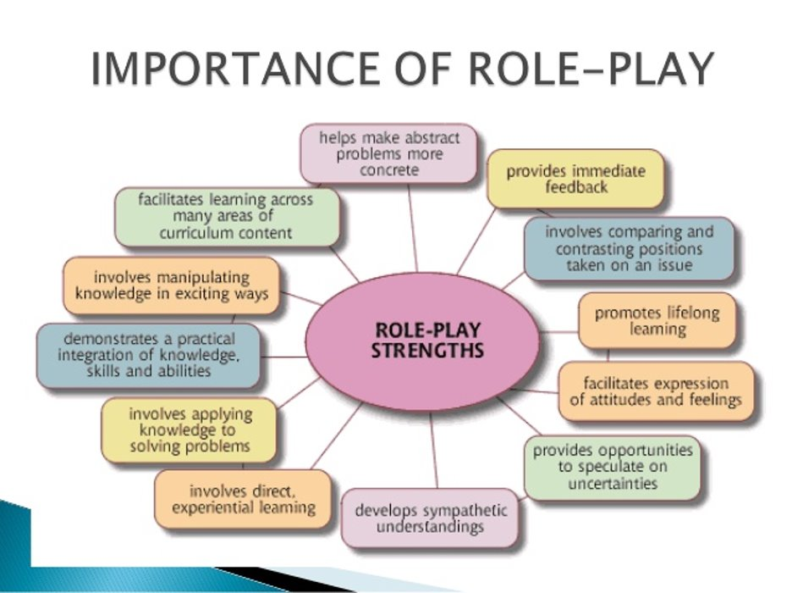

Slide 30
3.Evaluation of training

Slide 31
Evaluating of training – it’s systematic evaluation and assessment of information for deciding how best to utilize available resources in order to achieve organizational objectives.

Slide 32
Subjects of the evaluation process are:
Instructor – because they supply one of the most important sources of information as to how the instructor (as well as the trainee) is meeting the objectives of the unit of instruction.
Trainee – since what progress the trainee is making assist in the diagnosis of the areas of difficulty, helps distinguish between the relevant and the irrelevant, and can provide incentives towards greater effort.
HR manager – who uses tests to evaluate the capability of the instructor, teaching methods and materials and whether the training activities help in the attainment of the goals and objectives of the business.
Top manager – because of the value test results have in preparing reports on the effectiveness of the entire training and developing operation.

Slide 33
Training is done with specific objectives. Hence evaluation of training is a must. It is necessary in order to determine: if the developmental objectives were achieves; if the method of instruction was effective; if the best and the most economical training activities were organized and implemented.

Slide 34
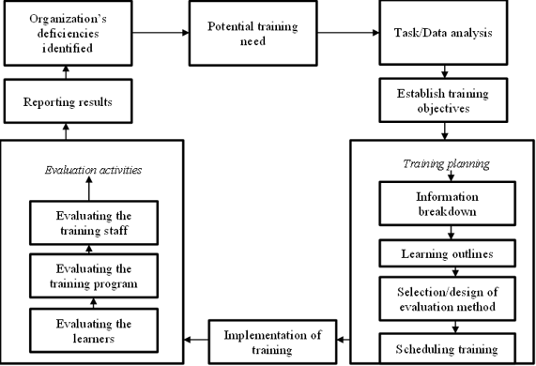
The importance of training evaluation is shown on the following diagram which shows the sequence of training activities.

Slide 35
Evaluation helps to tell us about the quality of the training on the one hand and the effects that it has created on the learners, on the other hand. Systematic evaluation can point out the weaknesses in the program, so that they could be corrected in the future programs. It can also indicate the extent to which learners have learned what been taught in the training sessions, the extent to which they have transferred their learning to the work situation and the results yielded thereafter.

Slide 36
Any evaluation begins with the criteria which depend on the objectives. Some of the criteria could be:
reaction of trainees – whether the participants liked or disliked the program;
learning – whether the concepts, ideas and principles of the training were intellectually assimilated by the participants;
behavioral changes – whether the training caused people to alter their behavior on the job;
impact on organizational effectiveness – whether the modified behavior caused positive results, such as an increased output, improved quality and lower costs.

Slide 37

The various methods of training evaluation are:
Observation
Questionnaire
Interview
Self diaries
Self recording of specific incidents

Slide 38
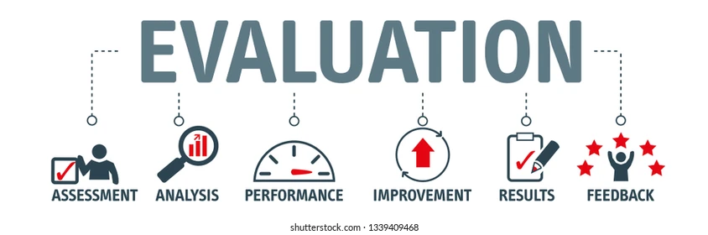
Types of evaluation
Evaluating the Training (includes monitoring) addresses how one determines whether the goals or objectives were met and what impact the training had on actual performance on the job.
Generally there are four kinds of standard training evaluation:
1. Formative
2. Process
3. Outcome
4. Impact.

Slide 39

Formative Evaluation.
Formative Evaluation may be defined as “any combination of measurements obtained and judgments made before or during the implementation of materials, methods, or programs to control, assure or improve the quality of program performance or delivery.”
It answers such questions as, “Are the goals and objectives suitable for the intended audience?” “Are the methods and materials appropriate to the event?” “Can the event be easily replicated?”
Formative evaluation furnishes information for program developers and implementers.

Slide 40

Process Evaluation
Process evaluation provides information about what occurs during training. This includes giving and receiving verbal feedback.
Process Evaluation answers the question, “What did you do?” It focuses on procedures and actions being used to produce results.
It monitors the quality of an event or project by various means. Traditionally, working as an “onlooker,” the evaluator describes this process and measures the results in oral and written reports.
Process evaluation is the most common type of training evaluation. It takes place during training delivery and at the end of the event.

Slide 41

Outcome Evaluation
Outcome evaluation determines whether or not the desired results (e.g., what participants are doing) of applying new skills were Achieved in the short-term.
Outcome Evaluation answers the question, “What happened to the knowledge, attitudes, and behaviors of the intended population?”
This project would produce both “outcomes” and “impacts.”
Outcome evaluation is a long-term undertaking.
Outcome evaluation answers the question, “What did the participants do?”

Slide 42

Impact Evaluation
Impact determines how the results of the training affect the strategic goal.
Impact Evaluation takes even longer than outcome evaluation and you may never know for sure that your project helped bring about the change.
Impacts occur through an accumulation of “outcomes.”

Slide 43
4.Activities of employee development

Slide 44
Many companies provide access to e-learning on topics including project management, software training and technical skills. Some will also provide reimbursement for their employees to attend professional conferences or certifications externally.

Slide 45
Employee Development is one of the most important functions of Human Resource Management. Employee development means to develop the abilities of an individual employee and organization as a whole so; hence employee development consists of individual or employee and overall growth of the employee as when employees of the organization would develop the organization, organization would be more flourished and the employee performance would increase.

Slide 46

Challenges in Employee Development
As employee development depends upon the individual employee whether employee is willing to participate or not. Employee development also depends upon the organization culture, attitude of top management, and limited opportunities of promotion.

Slide 47
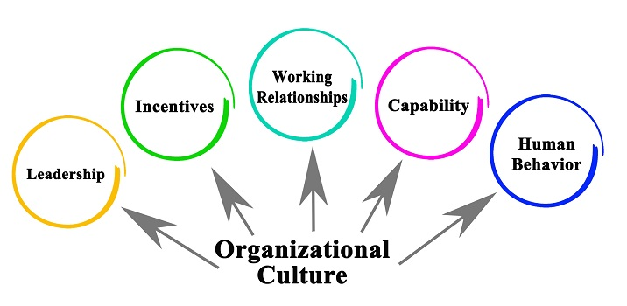
Organization Culture
If organization culture supports employees, it will encourage employees to participate in decision making then employees would more develop and performance would increase.

Slide 48

Attitude of Top Management
Top Management attitude is another important factor that influences on employee developmental activities. It depends on the sincerity and commitment of the top management.

Slide 49

Limited Opportunities of Promotion
If opportunities of promotion are limited then employees would not participate in the employee developmental activities.

Slide 50

Developmental Activities

Slide 51

Coaching
Coaching is an important activity for the employee development. Coaching is not formal. It involves treating employees as a personal partner in achieving both personal and organizational goals. Therefore, we can solve personal problems of the employees by providing coaching. When problems are resolved, this lead to increase in organizational performance as employees would be able to achieve organizational goals.

Slide 52
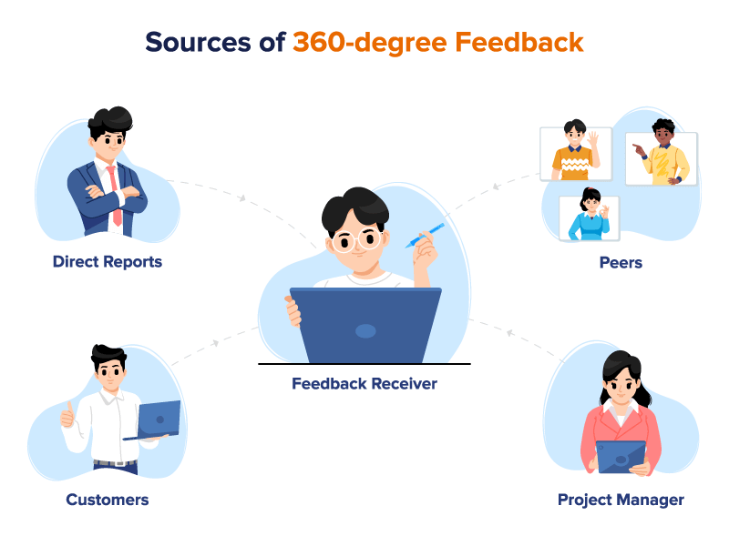
360 Degree Feedback and Developmental centers’
360 degree feedback and development centers are preplanned and are based on prior defined assessment criteria. As developmental centers‟ are present in the organization or there are many developmental centers outside the organization and are very important as they provide training to the individual employee. How to be developed and employees can only be developed if they have a desire or motivation to be developed.

Slide 53

Developmental Appraisal
Developmental appraisal is an ongoing process for the employee development during the whole year. Basically, it is a compulsory part of the Performance management. This appraisal will determine the weak area of employee where employee development is required in order to improve the employee performance.

Slide 54

Investment in Perceived Developmental Activities of the Employees
The investment in perceived developmental activities of the employee are important in order to increase the employee performance. As investment in perceived developmental activities also provide the organization as a competitive advantage.

Slide 55

Competitive Advantage
Most of the organizations do not consider the employee developmental activities of much value. They only focus on achieving the goals of the organization. They do not care about the development of employees. So, if organizations would focus on employee developmental activities, this would help in enhancing the skills of the employees.

Slide 56
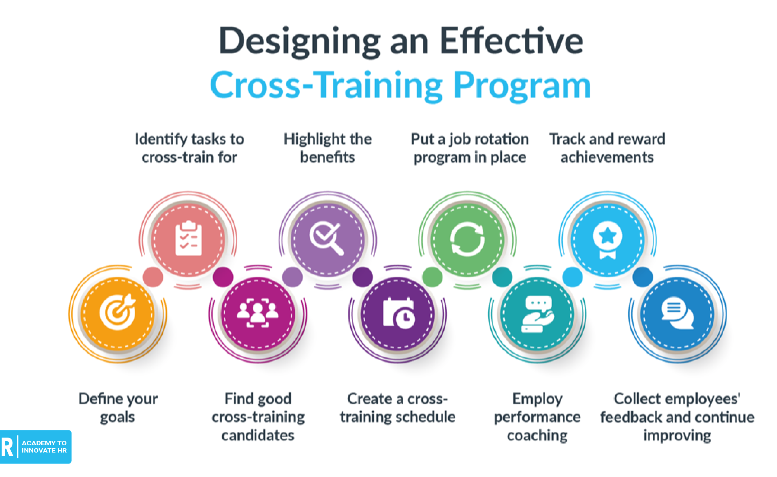
Cross-Training
Cross training is training someone in another activity that is related to their current work. The name comes from the fact that you are training them across a broader spectrum of the organization’s work. It provides more flexibility in managing the workforce to get the job done and it is good for employees too. It lets them learn new skills, makes them more valuable, and can combat worker boredom.

Slide 57

Formal Training
Formal classroom training is the first thing that comes to mind when people think of employee development. This is just one small component of the larger developmental plan. All employees are encouraged to take advantage of the training opportunities available internally and externally to enhance their support of bureau goals and their own professional development.

Slide 58

Matrix Teams
Matrix teams include work groups, cross functional teams, task forces, problem solving teams, committees, Special Project teams, etc. They are normally composed of a small number of people from different departments, functions, or organizations, who have banded together to solve a common problem or achieve a goal through collaboration and the sharing of their knowledge and skills.

Slide 59

Mentoring
There are many definitions of mentoring. In its simplest form, mentoring is the process of one person helping another to grow and develop. Mentoring occurs in several forms. However, all mentoring relationships fall into one of two categories: formal or informal.

Slide 60

A formal mentoring relationship is characterized by three traits:
1.An explicit agreement between mentor and protégé to engage in the mentoring process.
2.A specific set of developmental goals.
3.A structured process for the mentoring to take place (e.g., a formalized meeting schedule, an explicit agreement on roles and expectations, etc.)

Slide 61

Informal and Situational Mentoring
This type of mentoring relationship is characterized by a looser structure and less explicit agreement. Informal mentoring is almost always initiated by the individual mentor or protégé. An employee sees a quality in another person that they admire and would like to develop. Or a mentor sees something in another person that reminds them of themselves. If you have ever been “taken under someone’s wing,” that has most likely been an informal mentoring relationship.

Slide 62

Position Enhancement (Job Enlargement & Job Enrichment).
This involves modifying an employee’s responsibilities to meet a personal development objective. Job responsibilities are stretched in some way. This can either be vertical or horizontal. These can be permanent or temporary.

Slide 63
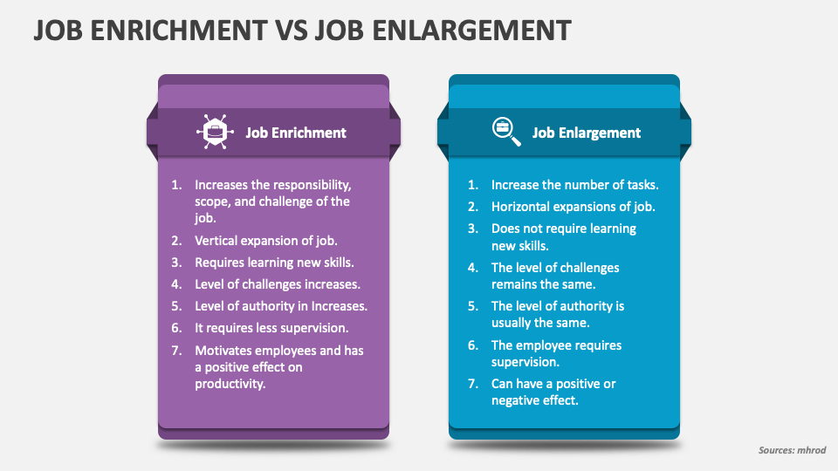

Slide 64

Job Enlargement is the horizontal expansion of a job. It involves the addition of tasks at the same level of skill and responsibility. It is done to keep workers from getting bored.
Job Enrichment is the addition to a job of tasks that increase the amount of employee control or responsibility. It is a vertical expansion of the job.

Slide 65
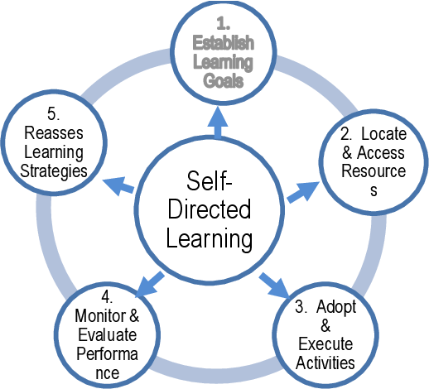
Self-Directed Learning Projects
An employee is assigned or voluntarily undertakes a specific project that promotes the expansion of skills and knowledge through self-directed learning or research and produces a final product that contributes to organizational objectives. Self-directed learning may also include reading, self-study, Distance Learning and different development courses.

Slide 66

Special Assignments
A Special Assignment is a learning strategy in which the employee performs temporary duties on a full or part-time basis. These duties may be performed within or outside the current organization. For example, the leader of a cross-functional team, service on a task force, etc.

